Slide 1
Taylor Course Selection
Future 9th grade
THINK. WORK. GROW.
#TAYLORPRIDE247

Slide 2
The Foundation High School Program
•All FHSP students must choose an endorsement in one of 5 areas at the time they enter 9th grade.
•Katy ISD students will select the endorsement along with their course selections.
•The endorsement should be selected based on the student’s individual interests and goals.
•Students will have the opportunity to change their endorsement if they so choose.
•The endorsement, and any changes, must be indicated in writing and signed by the parent.

Slide 3
Graduation Requirements & The Endorsements
22 Foundation Credits + 4 Endorsement Credits = 26 Total Credits
•STEM (Science – Technology – Engineering – Math)
•Business & Industry
•Public Services
•Arts & Humanities
•Multidisciplinary Studies

Slide 4
Graduation Requirements & The Endorsements
English – 4 credits
•English I, II, III, and an additional/advanced English
Math – 3 credits
•Algebra I, Geometry, and an additional/advanced math
Science – 3 credits
•Biology, and one course from IPC, or Chemistry, or Physics, and one additional/advanced science
Social Studies – 3 credits
•US History, .5 credit government, .5 credit economics, and either World History or World Geography
LOTE – 2 credits
•Credits must be in the same language
Fine Arts – 1 credit
Physical Education – 1 credit
Health – .5 credit (KISD requirement)
Electives – 4.5 credits, including
A communication skills component
+ Endorsement (4 additional credits)
Students are expected to earn an endorsement in one of 5 areas. Each endorsement requires:
a 4th math credit
a 4th science credit
2 additional electives

Slide 5
Graduation Requirements & The Endorsements
Communication Skills – Students on the FHSPE must have a communication skills component. The communication skills component can be satisfied through any of the following courses:
Professional Communications,
Communication Applications,
Debate,
Oral Interpretation,
Professional Standards in Agribusiness,
LeadWorthy,
Theatre, or
Dual Credit Speech
PE Substitutions – All students must earn one PE credit. The following are approved PE substitutions:
Athletics
Fall semesters of Marching Band I and Marching Band II
Fall semesters of Color Guard I and Color Guard II
Dance I
Dance Team Training I
Dance Team I,
Cheer – 1st year (if PE credit has not already been earned), or
NJROTC – 1st year.

Slide 6
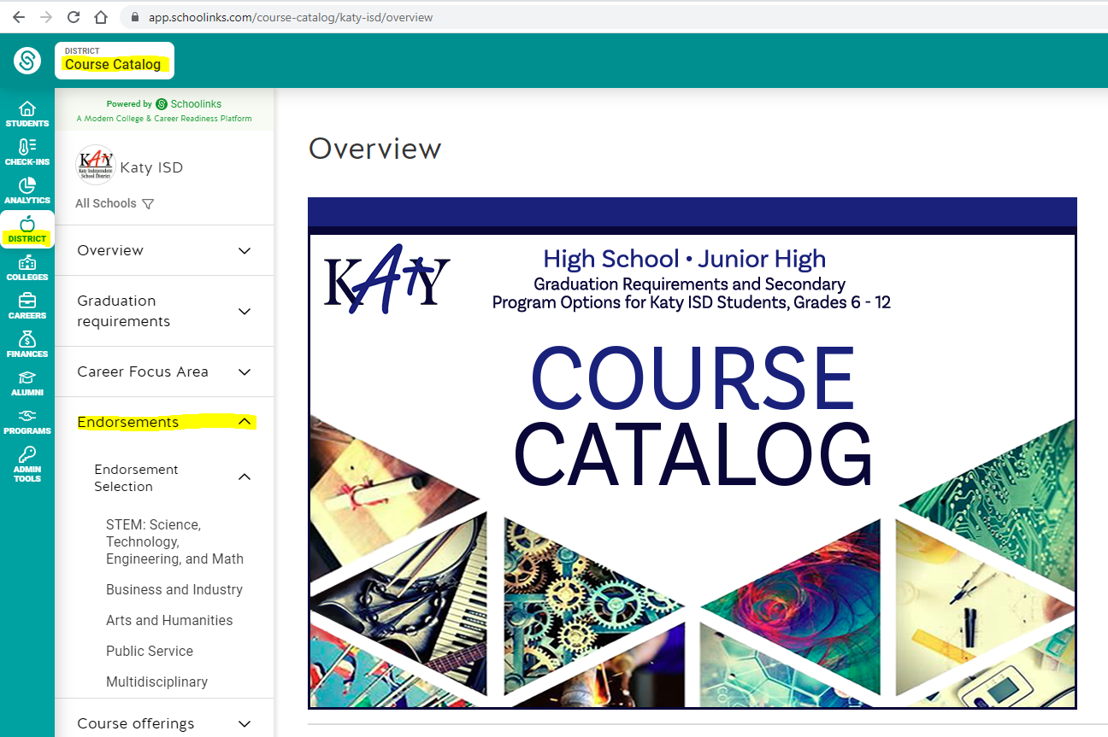
Graduation Requirements & The Endorsements
How to Look up Endorsements
Sign into Schoolinks in My KATY CLOUD.
Click on the District Tab.
Click on the Course Catalog.
Click on the Endorsements tab.

Slide 7
Texas Top 10% Admission Rule
A student whose class rank* is in the top 10 percent of the graduating class may be eligible for automatic admission consideration at a Texas public college or university.
*Class rank must be based on the student’s rank at the end of the 11th grade, middle of 12th grade, or at high school graduation, whichever is most recent at the college or university’s application deadline.
A student in the Top 10% of the graduating class is eligible for automatic admission consideration at Texas public colleges and universities, with the exception of the University of Texas at Austin.
Requirements to qualify for automatic admission consideration:
•Complete the FHSP + Endorsement, including the Distinguished Level of Achievement,
•Earn a satisfactory ACT or SAT score,
•Submit the application before the college or university’s deadline, and
•Provide a final high school transcript verifying completion of the FHSP + Endorsement, including the Distinguished Level of Achievement.

Slide 8
Texas First Diploma & Scholarship Program
A program to recognize high-achieving students
Eligible students can graduate early with Distinguished Level of Achievement and receive a scholarship (up to one year at a Texas college, university, or technical college).
Students who graduate 2+ semesters before their class will receive a 2 semester scholarship.
Students who graduate 1 semester early receive a 1 semester scholarship
Texas First Diploma does not guarantee automatic admission for students. Automatic admission qualifications should be discussed with a counselor
Student Eligibility:
Texas residency
FAFSA/TASFA completion
At least 22 high school credits
Final GPA=3.0 or higher on a 4.0 scale
Overall score in at least 80th percentile on ACT/SAT/PSAT/NMSQT/TSIA/TSIA2, or GED or top 10%
Completion of STAAR EOC exams in ENG 1 or 2, Algebra 1, and Biology
Demonstration of mastery in each subject of ELAR, Math, Science, SS, and foreign language

Slide 9
GT Social Studies
Students identified as GT in the area of Social Studies who elect to take KAP World Geography in the place of AP Human Geography GT will be exited from the GT program. In order to stay in the GT program for Social Studies, 9th graders will need to take AP Human Geography GT which is only offered during the school year (no summer school offering).
Students who elect to take KAP World Geography in summer school will be formally exited from GT.
A formal exit from Social Studies means the student will have to be re-screened and re-qualified to enroll in future GT social studies courses.
A formal exit in Social Studies does not have any bearing on other core content areas.

Slide 10
Virtual School Summer School
Cost - Most KVS courses are $200 per semester.
Registration Process
To register for a course through KVS:
All HS original credit will be online through KVS this summer. KVS registration begins at 7:00am on February 1. Students will register by visiting https://www.katyisd.org/Page/5000 and clicking on the Katy Virtual School Application link.
Registration for Summer & Fall 2024 will open February 1, 2024 at 7 AM. The last day to register will be May 27, 2024. The last day to drop with a refund is May 31, 2024.
Students entering the 9th grade can take the following:
World Geography KAP
World Geography
Liftetime Fitness and Wellness Pursuits (PE credit)
Health
Professional Communications
Math Models

Slide 11
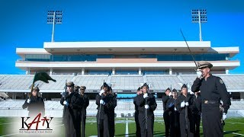
NJROTC Program
NJROTC can be used as a PE credit and there is no obligated military service; NJROTC is a citizenship and character development program.
Students must have their own transportation to/from Taylor to MCHS

Slide 12
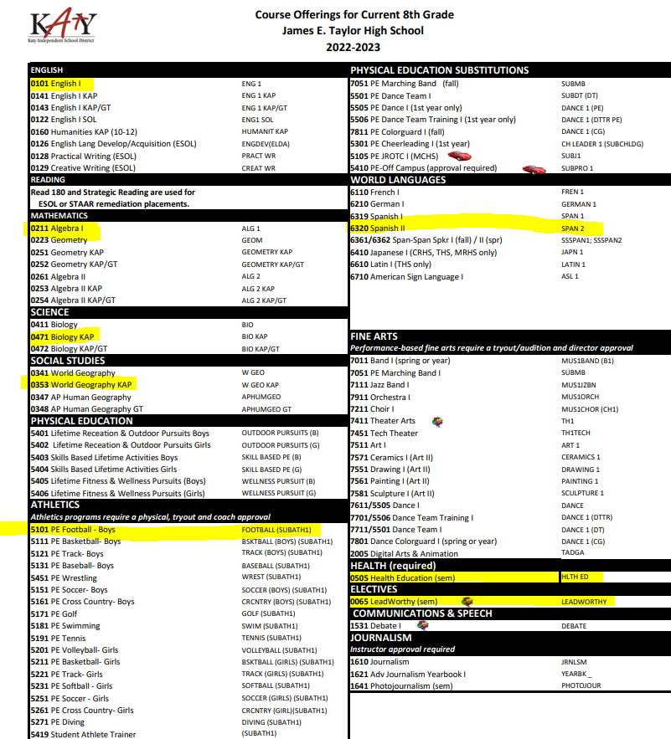
Course Selection Materials
Use this document to see which classes are available at Taylor. You can highlight classes you’re interested in taking
Pay attention to classes that are only 1 semester (indicated by “sem” next to the course name)
Athletic Trainer select PE and complete Application outside Counselors Office
If you’re Interested in FFA, enroll in 8110 Prin of Ag
If you’re interested in Yearbook, enroll in 1610 JRNLSM
You CANNOT take a High School Course that you took in JH again!
You do not have to turn this form in but you need to keep it for your records and SchooLinks.
ENTER COURSES IN SCHOOLINKS!!!
*Course Catalog In SchooLink

Slide 13
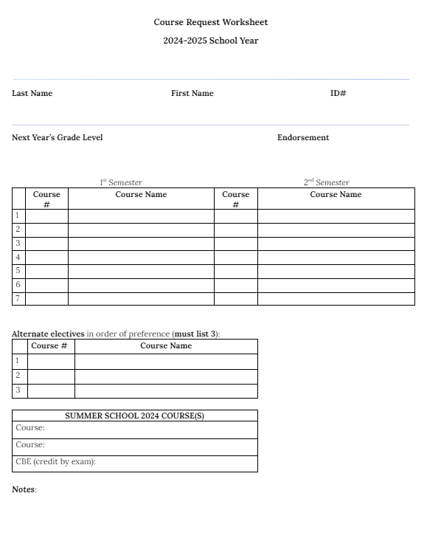
Course Request Worksheet
Use this paper to plan out your classes for 9th grade year
Remember that some classes you may want to take will only be 1 semester. Make sure you have 7 classes for the fall and 7 for spring semester
If you’re planning on playing multiple sports, list the sport that comes first in the calendar year
Make sure you list 3 alternate classes for your electives. If you don’t, you will go into whatever class has space
Keep in mind and record any classes you are planning on taking in the summer
Turn this paper into your ELA teacher
ENTER COURSES IN SCHOOLINKS!!!
*Course Catalog In SchooLinks

Slide 14
After today...
Turn in Course Request Worksheet to your ELA teacher by February 8th
Meet One-on-One W/ Counselor starting Monday, Feb 12th………
Later, course verification letters will be in SCHOOLINKS
THIS IS NOT A SCHEDULE!!!
Follow instructions for how to make changes on the course verification sheet and for parents to verify that all your classes are correct.

Slide 15
One-on-One
W/ Counselor
……….
YOU HAVE TO COMPLETE ONBOARDING BEFORE ENTERING COURSE
*Course Catalog in SchooLinks

Slide 16
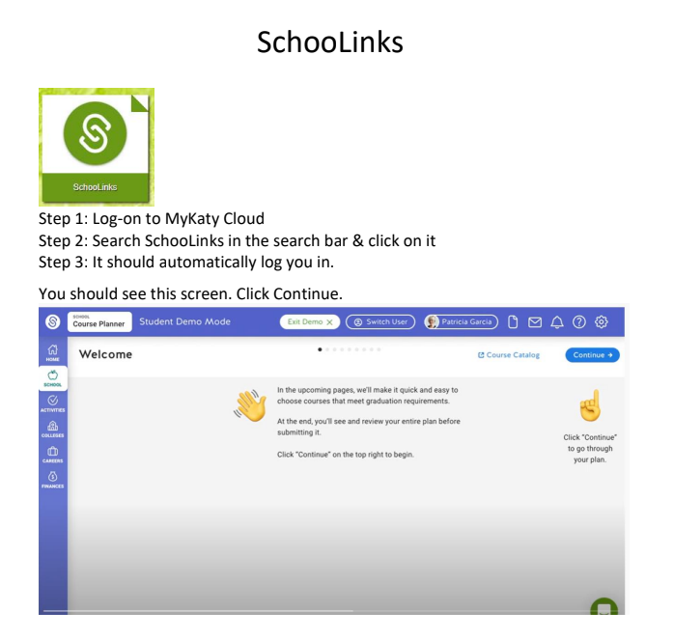
Course Selection Materials
SchooLinks Course Planning for High School
*Course Catalog In SchooLink

Slide 17
Face to Face Summer School
High School - Original Credit Courses Online registration opens February 1, 2024.
Registration process:
http://www.katyisd.org/dept/campusadmin/ksat/Pages/default.aspx No student is guaranteed a seat in any course until an email is received that they have been enrolled in the course. This email will also include information on how to pay the course fees. Once a course has met max seat capacity, the course will be closed.
UPDATED LIST HASN’T BEEN RELEASED YET

